Slide 1
ED fracture guidance set
In line with GIRFT Paediatric Trauma and Orthopaedic recommendations, BSCOS offers this ‘tool set’ of guidance sheets, designed to help bring consistent pre-specialist management and referral practices to bear on children’s fractures in your ED or referring treatment centres. It does not cover major trauma which should have its own specified pathway.
Variation in local practice is common and may reflect appropriate and necessary geographical and/or service delivery models. Those centres with virtual fracture clinic review may well have different follow up safety-netting to those without.
This guidance is not prescriptive – it is a starting point and is best jointly considered, adapted and agreed by representatives from your ED alongside Paediatric Orthopaedics.
It is suggested that referral criteria and other local service specific aspects of management are agreed and the sheets modified accordingly, noting the date of agreement and local contacts.
Clinical responsibility remains with the treating clinician at all times. BSCOS cannot take any responsibility for the contents of these guidance sheets.
BSCOS approved Patient Information Leaflets (PILs) will be hyperlinked to these documents as they become available.

Slide 2
Emergency Dept Fracture Management
BOAST guidance
The following BOA BOAST documents are relevant to the development of local ED protocols:
Management of paediatric acute musculoskeletal infection
Management of ACL injury in skeletally immature
Early management of paediatric forearm fracture
Supracondylar elbow fractures
BSCOS has issued guidance on virtual fracture clinics.

Slide 3
Emergency Dept Fracture Management Guidance: Principles
Appropriate clinical knowledge and clinical discretion remain essential when using these guidelines.
A) Assess – NB Mechanism (? Major Trauma), Distracting injuries, Temporary Splint/Analgesia.
Consider NAI –plausibility of mechanism, age of child, delay to presentation, prior history.
High index of suspicion = Major long bone # in <2y &/or multiple fractures of differing healing.
B) Best possible imaging - XR - AP & Lateral views – shaft fractures must include joint above and below. Ask for repeat views if necessary!
C) Classify – which bone(s), site (prox/med/distal), displacement (undisplaced, % diameter overlap), communition (fragmentation), angulation (sagittal/coronal/transverse planes), closed/open (contamination?), is a joint &/or physis involved?.
D) Definitive management – age (of patient), site and type specific. Discuss with Orthopaedics if in doubt
Immobilisation –
Consider - is it necessary? Some injuries will heal with no restriction, or a removable splint
Plaster of Paris is best for moulding (ie to hold the position of a fracture that is likely to displace).
Softcast is best for removal at home (ie where the fracture is unlikely to displace).
Resin is best for lightweight strength (ie when weightbearing) and poor for moulding
Ongoing treatment plan - Consider - is review necessary? Some injuries do not require further treatment.
Issue patient Info leaflets where relevant.
Links to studies (where relevant):
Local modification date/trust/HB:

Slide 4
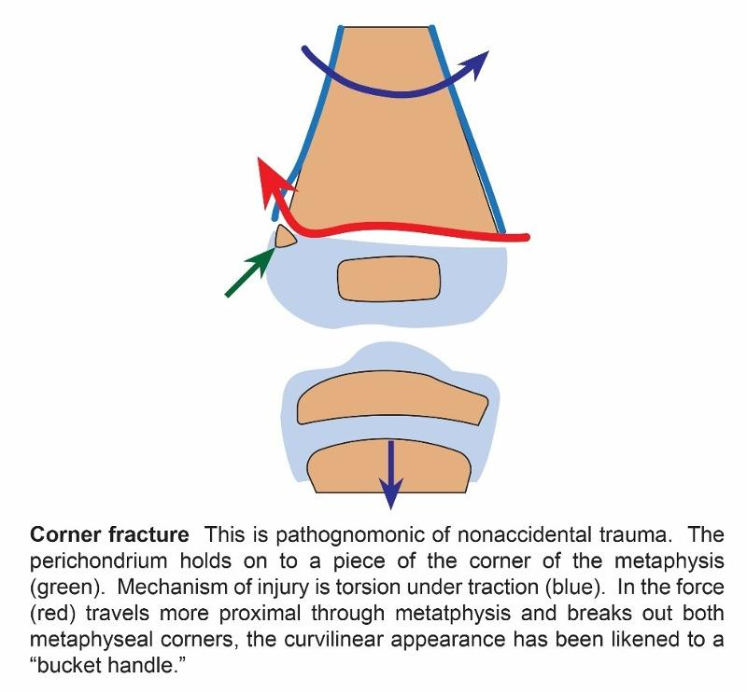
Emergency Dept Fracture Management Guidance: NAI
Appropriate clinical knowledge and clinical discretion remain essential when using these guidelines.
Assess – Delayed presentation?
Inconsistent mechanism or history changes.
Check child at risk register.
High index of suspicion =
Major long bone # in <2y Metaphyseal corner fractures / ‘Bucket handle fractures’
Multiple fractures of differing healing. Ribs/Skull/Scapula/Sternum fractures
B) Best possible imaging of injured area - XR - AP & Lateral views
C) Classify – Bone(s) involved, site (prox/mid/distal), comminution,
D) Document carefully
Discuss with child protection
Definitive management –refer Ortho
Missed NAI carries a high mortality
Links to studies (where relevant):
Local modification date/trust/HB:

Slide 5
Emergency Dept Fracture Management Guidance:
Upper Limb / Clavicle
Appropriate clinical knowledge and clinical discretion remain essential when using these guidelines.
A) Assess – NB Mechanism (? Major Trauma).
Caution - Sternoclavicular joint disruption – rare - refer urgently if clavicle posteriorly displaced.
B) Best possible imaging - XR - AP & 20 cephalad views
C) Classify –site (med – SC Jt/shaft/distal – AC Jt), displacement (undisplaced, % diameter overlap), angulation, communition (fragmentation), angulation, closed/open (contamination?).
D) Definitive management –
Un/Minimal displaced – Broad arm sling 2-4 weeks, avoid sports – No follow up.
Displaced – Figure of 8 brace – Instructions to tighten – Follow up 1/52
AC Joint disruption – Broad arm sling 2 weeks – No follow up under 12y.
Links to studies (where relevant):
Local modification date/trust/HB:

Slide 6
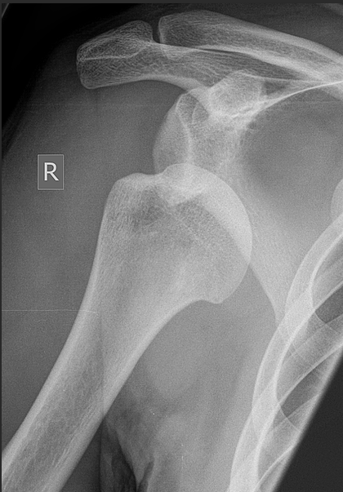
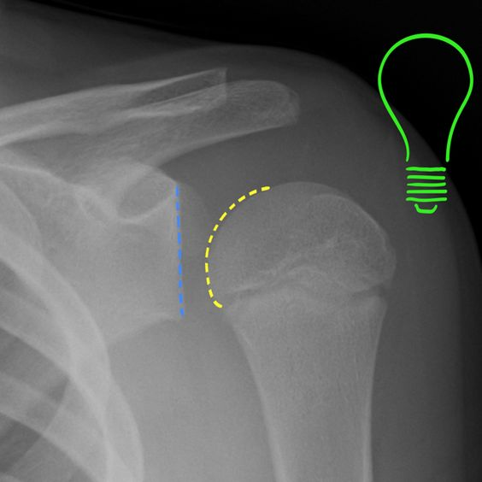
Emergency Dept Fracture Management Guidance:
Upper Limb / Glenohumeral dislocation
Appropriate clinical knowledge and clinical discretion remain essential when using these guidelines.
A) Assess – NB Mechanism – Trauma / Previous dislocations.
Caution – check and document distal NV function before treatment
B) Best possible imaging - XR - AP, scapular lateral +/or axillary
C) Classify –displacement (anterior/posterior-‘light bulb sign’ /inferior ‘luxatio erecta’), associated fractures.
D) Definitive management – Reduction under sedation then polysling
Atraumatic – physio OPD referral
Traumatic (eg rugby) – consider MRI
Associated fracture – refer to Orthopaedics
Links to studies (where relevant):
Local modification date/trust/HB:

Slide 7
Emergency Dept Fracture Management Guidance:
Upper Limb / Humerus
Appropriate clinical knowledge and clinical discretion remain essential when using these guidelines.
A) Assess – NB Mechanism – (? Major Trauma).
Caution – check and document radial N function before treatment
B) Best possible imaging - XR - AP, scapular lateral +/or axillary
C) Classify – site (prox/med/distal), displacement (undisplaced, % diameter overlap), communition (fragmentation), angulation (sagittal/coronal/transverse planes), closed/open (contamination?), is a joint &/or physis involved?.
D) Definitive management –
Humeral brace or J-slab
Collar & cuff
Fracture clinic 1/52
Links to studies (where relevant):
Local modification date/trust/HB:

Slide 8
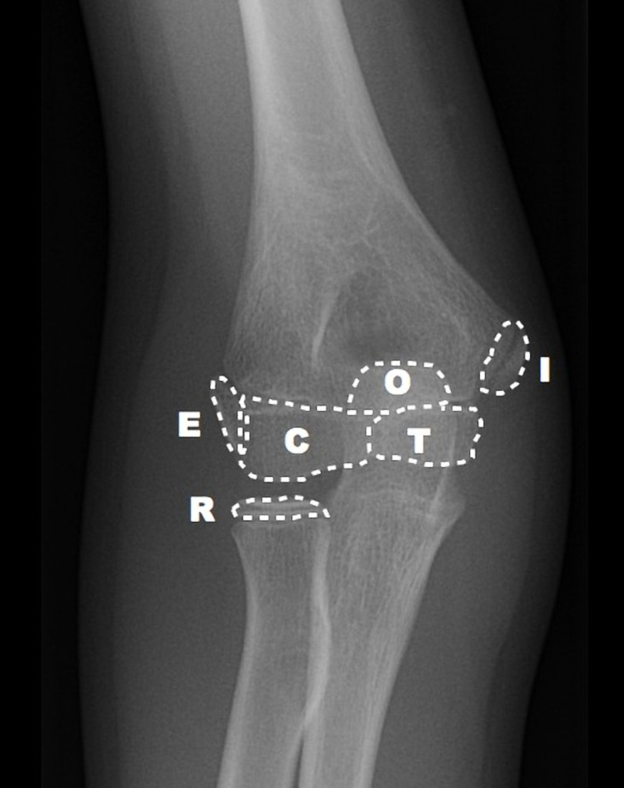
Emergency Dept Fracture Management Guidance:
Upper Limb / Epicondyles of Elbow
Appropriate clinical knowledge and clinical discretion remain essential when using these guidelines.
A) Assess – NB Mechanism – typically a fall onto outstretched hand – (? Major Trauma).
Caution – do not mistake condylar for epicondylar fracture
B) Best possible imaging - XR - AP & lateral elbow
C) Classify – note normal ossific nuclei timing
Appears Fuses
Capitellum 1 12-14
Radial Head 3 14-16
Internal (Medial) 5 16-18
Trochlear 7 12-14
Olecranon 9 15-17
External (lateral) 11 12-14
D) Definitive management –
Medial - Undisplaced (suspected) – Broad arm sling –2/52, No FU
- Displaced - Backslab, refer Orthopaedics
Lateral - <2mm displaced - Backslab, 1/52 FU
- >=2mm displaced or suspicion of condylar – refer Ortho
Links to studies (where relevant):
Local modification date/trust/HB:

Slide 9
Emergency Dept Fracture Management Guidance:
Upper Limb / Supracondylar elbow
Appropriate clinical knowledge and clinical discretion remain essential when using these guidelines.
A) Assess – NB Mechanism – (? Major Trauma).
Caution – check and document distal NV function before treatment
B) Best possible imaging - XR - AP & lateral elbow
C) Classify – Gartland, closed/open (contamination?)
D) Definitive management – flexion type – (less stable) - apply backslab, refer Ortho
- extension type - see below
NB see: https://www.boa.ac.uk/static/a240155a-f0dd-4be7-8c8af7b6cc4da795/BOASTSupracondylarFracturesHumerusChildren2020-v2-FINAL.pdf
(or suspected but normal XR)
Broad arm sling 1-2/52
No follow up
(and/or NV compromise)
Backslab
Refer Orthopaedics
(and/or NV compromise)
Backslab
Refer Orthopaedics
Links to studies (where relevant):
Local modification date/trust/HB:

Slide 10
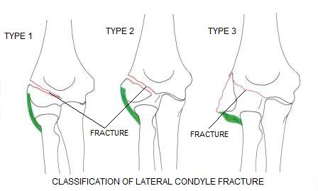
Emergency Dept Fracture Management Guidance:
Upper Limb / Lateral condyle of Elbow
Appropriate clinical knowledge and clinical discretion remain essential when using these guidelines.
A) Assess – NB Mechanism – typically a fall onto outstretched hand – (? Major Trauma).
Caution – do not mistake for epicondylar fracture
B) Best possible imaging - XR - AP & lateral elbow
C) Classify – Weiss [NB ossific nucleus appears 11yoa, fuses 12-14yoa]
D) Definitive management – depends on articular disruption, may be obscure if cartilaginous
Type 1 - only if certain, backslab, F/U 1/52
Types 2 & 3 (or uncertain) – backslab, refer Ortho
Links to studies (where relevant):
Local modification date/trust/HB:

Slide 11
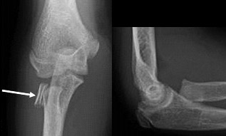
Emergency Dept Fracture Management Guidance:
Upper Limb / Radial head & neck
Appropriate clinical knowledge and clinical discretion remain essential when using these guidelines.
A) Assess – NB Mechanism – typically a fall onto outstretched hand – (? Major Trauma).
Caution –watch out for an absent (ie displaced) radial head ossific nucleus after 3yoa
B) Best possible imaging - XR - AP & lateral elbow
C) Classify – Radial head ossific nucleus appears 3yoa, fuses 14-16yoa
D) Definitive management –
Undisplaced/suspected or Angulated <30 deg – Broad arm sling (under clothing) for 2-4w, No F/U
Displaced or Angulated >30 deg – Refer Orthopaedics
Links to studies (where relevant):
Local modification date/trust/HB:

Slide 12
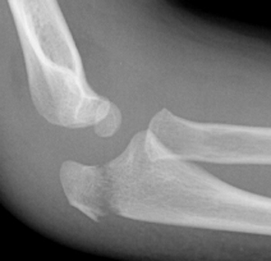
Emergency Dept Fracture Management Guidance:
Upper Limb / Olecranon
Appropriate clinical knowledge and clinical discretion remain essential when using these guidelines.
A) Assess – NB Mechanism – (? Major Trauma).
Caution – check for evidence of subluxation and alignment of radial head with capitellum
B) Best possible imaging - XR - AP & lateral elbow
C) Classify – NB ossific nucleus appears 9yoa, fuses 15-17
D) Definitive management –
Undisplaced/suspected – Backslab/softcast, to remove at home 3/52, No F/U
Displaced or Angulated – Refer Orthopaedics
Any misalignment of radiocapitellar joint?
– consider Monteggia – refer Orthopaedics
Links to studies (where relevant):
Local modification date/trust/HB:

Slide 13
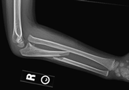
Emergency Dept Fracture Management Guidance:
Upper Limb / Forearm
Appropriate clinical knowledge and clinical discretion remain essential when using these guidelines.
A) Assess – NB Mechanism – (? Major Trauma).
Caution – check for evidence of subluxation and alignment at wrist and elbow
B) Best possible imaging - XR - AP & lateral forearm (to include elbow and wrist)
C) Classify
– Plastic deformation (younger child, no fracture but NB radiocapitellar and DRUJ)
Ulnar fracture, Radius intact (NB Monteggia – radiocapitellar sublux – see image below)
Radial fracture, Ulna intact (NB Galeazzi – DRUJ sublux)
Both bone forearm – displacement, angulation, open/closed
D) Definitive management –
Undisplaced/suspected – Backslab/softcast, to remove
at home 3/52, No F/U
Plastic deformation - Backslab then refer orthopaedics
Monteggia/Galeazzi – Backslab then refer orthopaedics
Displaced or Angulated – Backslab then refer orthopaedics
Links to studies (where relevant):
Local modification date/trust/HB:

Slide 14
Emergency Dept Fracture Management Guidance:
Upper Limb / Wrist
Appropriate clinical knowledge and clinical discretion remain essential when using these guidelines.
A) Assess – NB Mechanism – fall onto outstretched hand typically.
Caution – check for evidence of subluxation and alignment at wrist and elbow
B) Best possible imaging - XR - AP & lateral centred on wrist [NOT full forearm XR]
(consider additional AP & lat elbow if any tenderness/deformity)
C) Classify
– torus (unicortical plastic deformation)/greenstick (torus one cortex, fracture of the other)/bicortical, angulation, displacement, comminution, open/closed
D) Definitive management –
Torus/Buckle (unicortical) – no brace required, futuro splint for comfort
Greenstick/Undisplaced/min angulation <15 deg (bicortical) – softcast/backslab, remove at home 3/52 – No F/U
Displaced/signif angulation/physis involved – backslab, refer to Orthopaedics - consider CRAFFT
NB see https://www.boa.ac.uk/static/57ea20ec-8edb-46ce-879222a813ce9af6/BOAST-Paediatric-Forearm.pdf
Links to studies (where relevant):
Local modification date/trust/HB:

Slide 15
Emergency Dept Fracture Management Guidance:
Upper Limb / Carpus
Appropriate clinical knowledge and clinical discretion remain essential when using these guidelines.
A) Assess – NB Mechanism –
Caution – missed scaphoid carries an increased avascular necrosis risk
B) Best possible imaging - XR – Scaphoid series
C) Classify
– proximal pole / waist / distal pole of scaphoid ?
- displacement ?
D) Definitive management – Scaphoid
<9y - highly unlikely to be fractured (cartilaginous) - seek advice if signif concern.
>9y - clinical suspicion only – extended futuro splint 2/52, F/U if ongoing symptoms
- undisplaced fracture on XR – scaphoid cast 6-8 weeks, 6/52 F/U
- displaced fracture on XR – refer to ortho
- Any other carpal fracture – refer to ortho (or hand service)
Links to studies (where relevant):
Local modification date/trust/HB:

Slide 16
Emergency Dept Fracture Management Guidance:
Upper Limb / MCs & phalanges
Appropriate clinical knowledge and clinical discretion remain essential when using these guidelines.
A) Assess – NB nerve and tendon fcn, significant soft tissue injury – consider plastic surgery input.
Caution – check and document rotational deformity of digits
B) Best possible imaging - XR – PA and true lateral views of any confirmed fractures
[obliques are good for diagnostic sensitivity but not for assessment of displacement]
C) Classify
– named digits [use: thumb, index, long, ring, little], prox/mid/distal, open/closed, oblique/tvse/spiral, comminution, displacement.
D) Definitive management – Scaphoid
D) Definitive management
Base of MC – ulnar gutter for little/ring finger – refer hand service
CMC dislocation - reduce under analgesia – refer hand service
Undisplaced MC shaft - buddy strap+futuro – No F/U unless stability concern
Multiple MC # - volar slab in position of safe immobilization (CMCjts at 90, IPJs at 180 deg) – refer
Undisplaced MC neck - buddy strap+futuro – No F/U unless stability concern
Angulated/rotated MC shaft/neck – refer hand service
Volar plate injury - buddy strap – No F/U
Bony mallet/Nail bed injury/suspected infection – refer hand service
Links to studies (where relevant):
Local modification date/trust/HB:

Slide 17
Emergency Dept Fracture Management Guidance:
Spine
Appropriate clinical knowledge and clinical discretion remain essential when using these guidelines.
A) Assess – NB Mech of injury – Risk of (missed) major trauma. Document distal NV status on arrival
Caution – high risk of distracting injury – undertake a secondary survey
B) Best possible imaging – CT vs XR – d/w radiology / as per local protocol
C) Classify
– Cervical / Thoracic / Lumbar / Sacral
D) Definitive management –
Immobilise
Refer to orthopaedics
Links to studies (where relevant):
Local modification date/trust/HB:

Slide 18
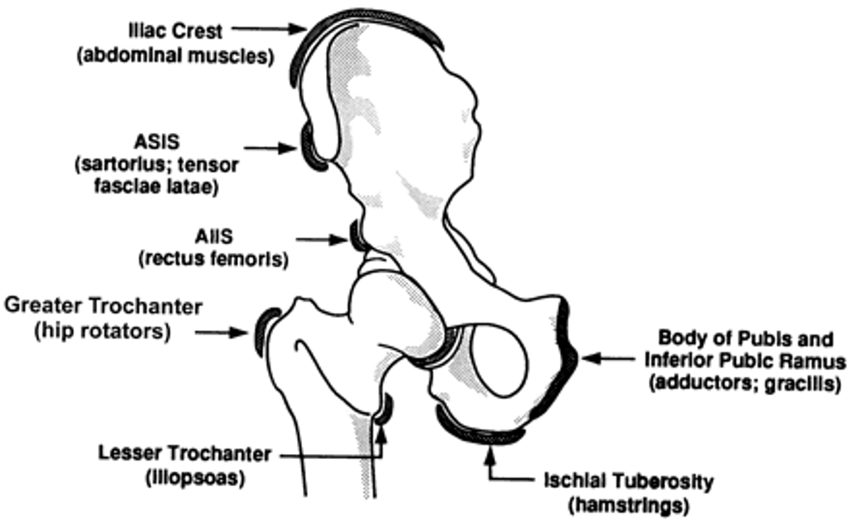
Emergency Dept Fracture Management Guidance:
Lower Limb/Pelvis & Hip
Appropriate clinical knowledge and clinical discretion remain essential when using these guidelines.
A) Assess – NB Mech of injury – Risk of (missed) major trauma.
Caution – high risk of distracting injury – undertake a secondary survey
SUFE is often missed – beware groin pain in the adolescent
B) Best possible imaging – AP Pelvis XR (+ frog lateral in suspected SUFE)
C) Classify
– Minor Avulsions v Injury to Pelvic Ring v SUFE
D) Definitive management –
Avulsion (of apophyses/trochanter) – crutches, analgesia, physio referral
Major trauma - immobilise,Consider pelvic binder - Refer to orthopaedics
SUFE – refer to ortho
Perthes – arrange f/u in elective paeds ortho service
Links to studies (where relevant):
Local modification date/trust/HB:

Slide 19
Emergency Dept Fracture Management Guidance:
Lower Limb / Femur
Appropriate clinical knowledge and clinical discretion remain essential when using these guidelines.
A) Assess – NB record distal neurovasc status. Apply Thomas Splint +/- Fem N Block for pain relief.
Caution – refer for consideration of NAI in the non-ambulant infant!
B) Best possible imaging - XR = PA and true lateral views
C) Classify
– prox/mid/distal, open/closed, oblique/tvse/spiral, comminution, displacement.
D) Definitive management –
Refer to orthopaedics
Links to studies (where relevant):
Local modification date/trust/HB:

Slide 20
Emergency Dept Fracture Management Guidance:
Lower Limb – Patella
Appropriate clinical knowledge and clinical discretion remain essential when using these guidelines.
A) Assess – NB Mech of injury – trauma or atraumatic ?
Caution – always assess integrity of extensor mech with SLR.
B) Best possible imaging – AP & lat knee (+/- skyline view)
C) Classify
– First time dislocation v recurrent
- Displacement of a fracture.
D) Definitive management
Dislocated patella – reduce with sedation
First time dislocation - refer to Orthopaedics
Recurrent dislocation – check XR for osteochondral lesions – refer to physio
Fracture
Undisplaced with intact ext mech – resin full leg cast, F/U 1/52
Displaced – refer to orthopaedics.
Links to studies (where relevant):
Local modification date/trust/HB:

Slide 21
Emergency Dept Fracture Management Guidance:
Lower Limb – Knee Jt
Appropriate clinical knowledge and clinical discretion remain essential when using these guidelines.
A) Assess – NB Mech of injury – trauma or atraumatic ?
Caution – always assess integrity of extensor mech with SLR.
B) Best possible imaging – AP & lat knee (+/- skyline view)
C) Classify
– Grade laxity (cf contralat side) if ligamentous injury.
Site of any osteochondral fracture, displacement. Lipohaemarthrosis?
Segond fractures = avulsion of collateral ligament
Tibial spine (ACL) avulsion displacement
Tibial tuberosity fracture displacement
D) Definitive management
‘Soft tissue’ injury without lipohaemarthrosis – - Cricket splint, crutches, urgent physio referral
Lipohaemarthosis w/out obvious # - Cricket splint, crutches - d/w Orthopaedics during working day
Segond or Tib spine or tuberosity fracture - refer Ortho
Osteochondral lesion – d/w Orthopaedics during working day
NB see: https://www.boa.ac.uk/asset/EA032921%2D2A7F%2D4A15%2D8F7033524E4678D5/
Links to studies (where relevant):
Local modification date/trust/HB:

Slide 22
Emergency Dept Fracture Management Guidance:
Lower Limb – Tibia & Fibula
Appropriate clinical knowledge and clinical discretion remain essential when using these guidelines.
A) Assess – NB Mech of injury – trauma or atraumatic ?
Caution – Beware compartment syndrome.
B) Best possible imaging – AP & lat (to include knee and ankle joints)
C) Classify
Bone(s) involved, Site (Prox/Shaft/Distal), Open/closed, Comminution, Displacement, Angulation.
D) Definitive management
‘Toddler’s fracture’ - undisplaced <5yo - softcast/backslab x3/52, No F/U
- clin suspicion (XR normal) – consider analgesia only or as above.
Fibular neck # - check comm peroneal nerve, check ankle (Maisonneuve)
Tibial prox metaphysis – long leg cast, refer Ortho – risk of late valgus (Cozen’s phenomenon)
Tibial shaft – undisplaced - long leg cast NWB – FU 1/52
- displaced/angulated - AK backslab, refer Ortho
Links to studies (where relevant):
Local modification date/trust/HB:

Slide 23
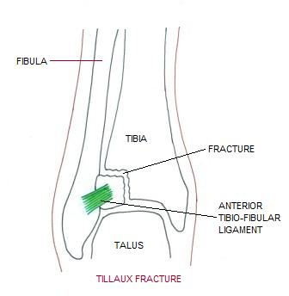
Emergency Dept Fracture Management Guidance:
Lower Limb – Ankle/Hindfoot
Appropriate clinical knowledge and clinical discretion remain essential when using these guidelines.
A) Assess – NB Mech of injury – trauma or atraumatic ?
Caution – Talar neck fractures are easily missed and carry high risk of AVN
B) Best possible imaging – AP & lat ankle, AP & oblique foot (+ true lat of foot if any tarsal fracture)
C) Classify
– Tillaux = SH 3 anterolat tib epiphyseal avulsion, adolescents only
- Triplane = sagittal, coronal and transverse plane fracture, (SH 2 on one view and SH 3 on the other)
D) Definitive management
- Signif sprain/avulsion/undisplaced # = Splint/Moonboot 2-4/52 No FU
Displaced fracture / Talar shift = Backslab, refer Ortho
Triplane & Tillaux – Backslab, refer Ortho, consider CT scan
Talar dome or neck fracture = Backslab, refer Ortho
Tarsal avulsion fractures = WB BK cast, FU 1/52
Calcaneal fracture – elevate, refer Ortho
Ligamentous disruption (Lisfranc injury) – true lat XR – refer Ortho
Links to studies (where relevant):
Local modification date/trust/HB:

Slide 24
Emergency Dept Fracture Management Guidance:
Lower Limb – Foot
Appropriate clinical knowledge and clinical discretion remain essential when using these guidelines.
A) Assess – NB Mech of injury – trauma or atraumatic ?
Caution –
B) Best possible imaging – AP & oblique [+true lat if fracture is diagnosed]
C) Classify
– Bone(s) involved, site (prox/mid/distal), comminution, open/closed, displacement/angulation
D) Definitive management
Significant crush (irrespective of fractures )– consider compartment synd – elevate, refer Ortho
MT fractures
Undisplaced/base of 5th avulsion - sturdy (stiff soled) footwear or moonboot x2-3/52, No FU
Displaced – refer Ortho
Phalanges
Undisplaced – sturdy shoes, No FU
Displaced – slipper cast or boot, FU only for Gt toe
Links to studies (where relevant):
Local modification date/trust/HB:

